Slide 1
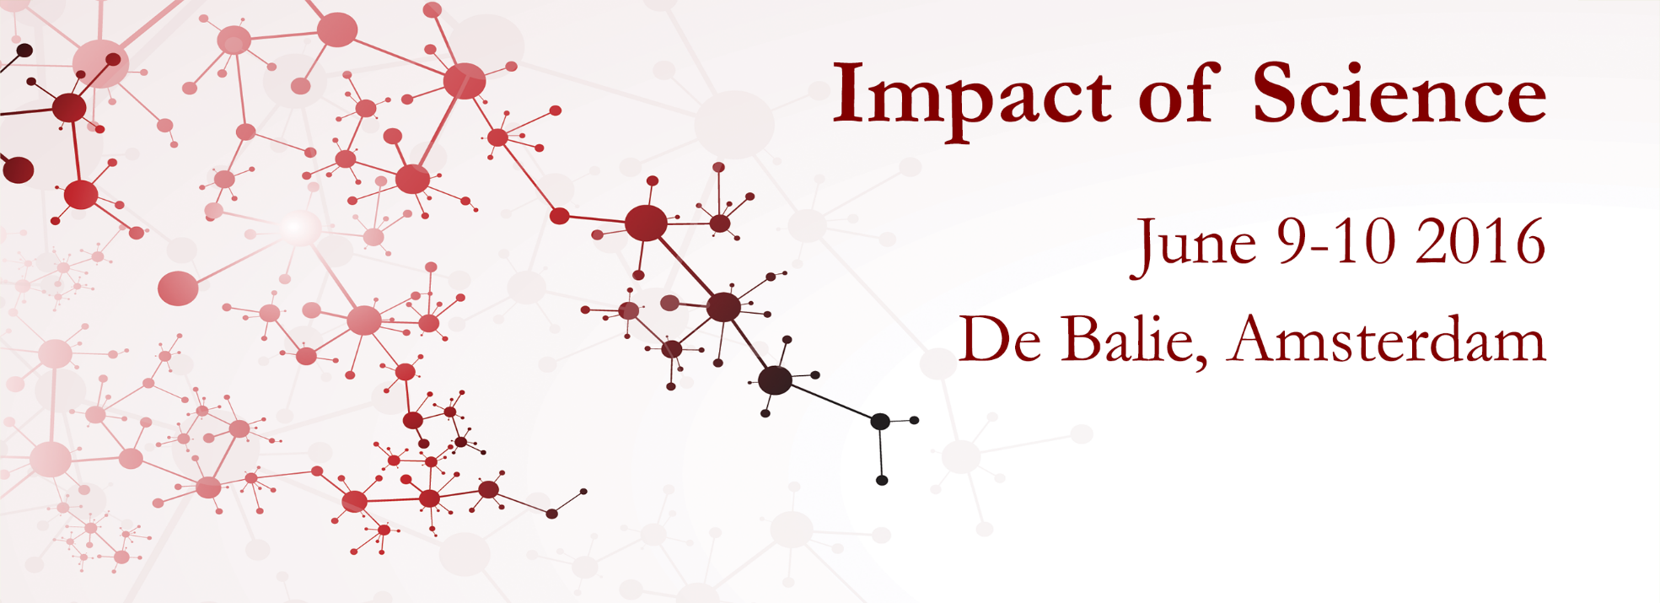

Impact of Social Sciences, Humanities and Arts Conference
The Parallel Session on:
Science Communication and Public Engagement
14 October, 2021

Slide 2
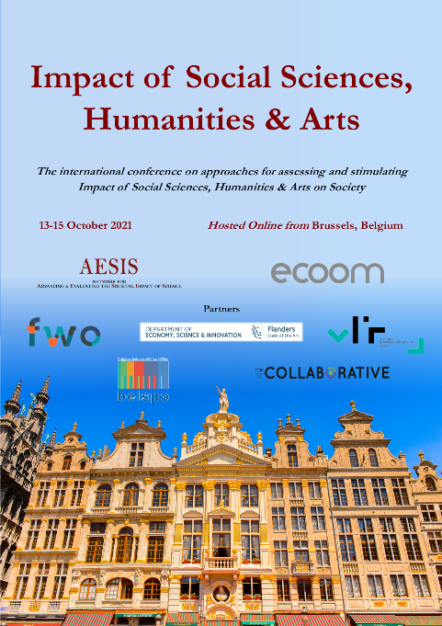

Impact of Social Sciences, Humanities and Arts
13-15 October, 2021
Jenny Björkman: Director of Collaboration, Riksbankn Jubileumsfond, Sweden
Malinda Smith: Vice-Provost Equity, Diversion & Inclusion, University of Calgary, Canada
Hans Jonker: Researcher in the ECOOM unit, Vrije Universiteit Brussel (VUB), Belgium
Florian Vanlee (Moderator): Postdoctoral Researcher on Evaluating Artistic Research, ECOOM, Brussels, Belgium
Overview of the Speakers
#SSHA21

Slide 3
Impact of Social Sciences, Humanities and Arts
13-15 October, 2021
Jenny Björkman
Director of Collaboration, Riksbankn Jubileumsfond, Sweden
#SSHA21

Slide 5
Riksbankens Jubileumsfond (RJ)
is an independent foundation with the goal of promoting and supporting
research in the Humanities and Social Sciences with
links to Sweden.
text

Slide 6
One of Sweden’s leading funding organizations of humanities and social sciences research
AWARDED GRANTS 2010–2019

Slide 7
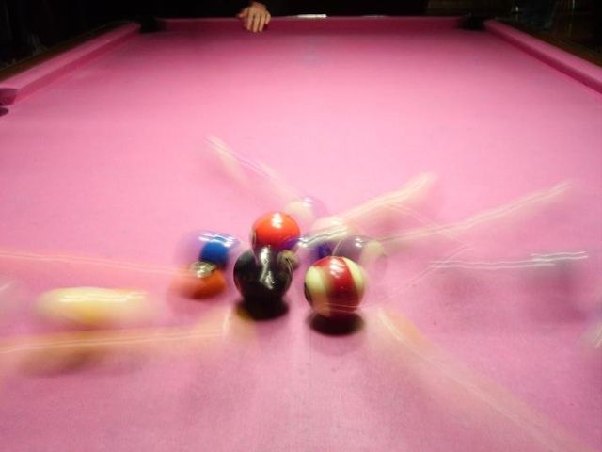



Impact, science communication and evaluations
Evaluating impact in order to work more effective
640px-Biljard.JPG (640×480) (wikimedia.org)

Slide 8
TWIST – a short film project
Independent of the research that is being told.
Artistic language combined with facts
Heart and brain, where something unexpected can happen

Slide 9

A research-project that became a film
Gregor Noll et al:
Digitalized Warfare: Responsibility, Intentionality and the Rule of Law
The research highlights the ethical challenges presented by the accelerated advance of Artificial Intelligence (AI) in the absence of public policy and industry standards to ensure development in the public interest.

Slide 10

Impact evaluation was employed to assess whether seeing the film caused changes in knowledge, awareness, attitudes, and actions .
text

Slide 11

Learnings
Impact through artistic film is possible!
Impact evaluation is an effective method to measure the effect.
Templates and models can help researchers.
The broader public exists and can be reached.

Slide 12
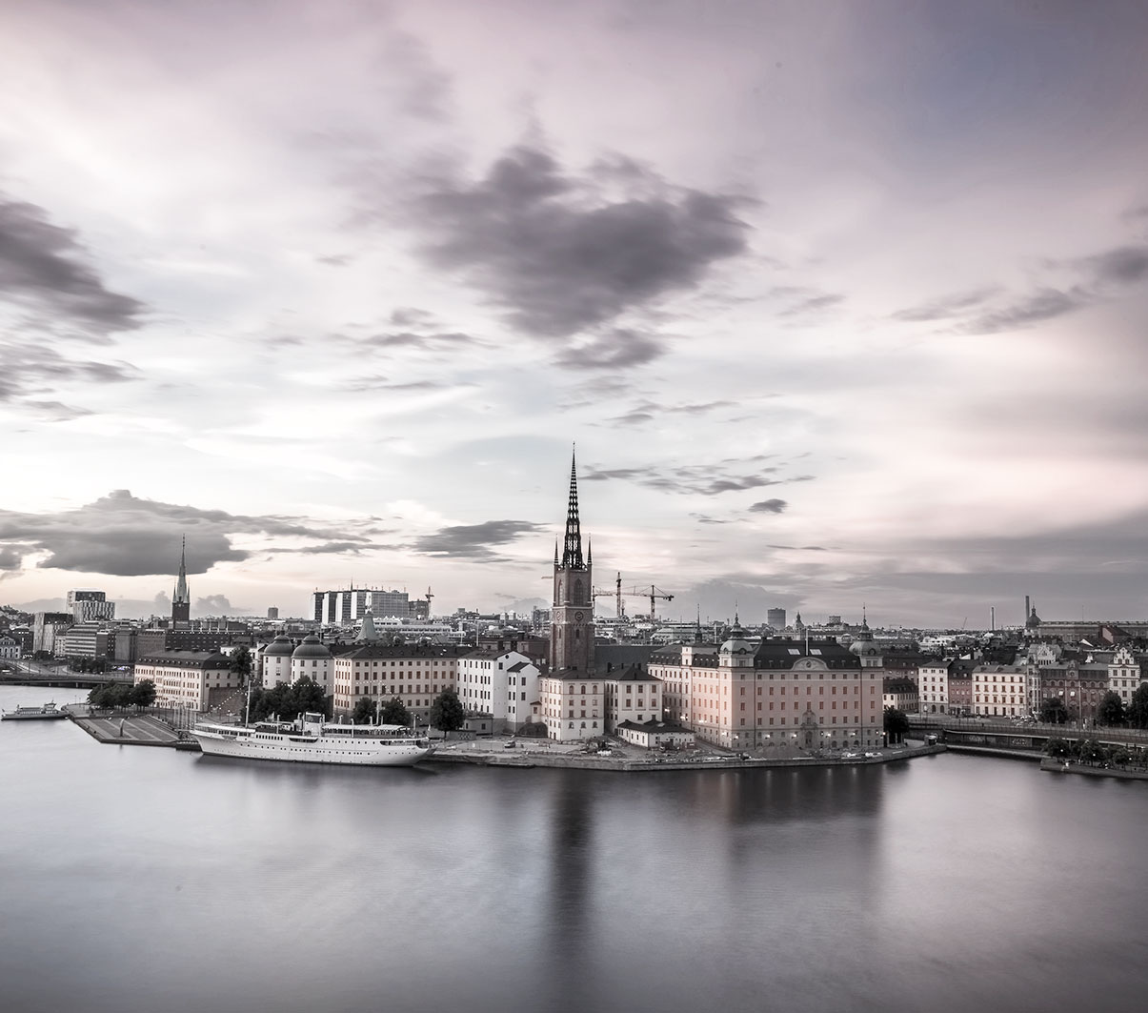
  TACK!
  Stiftelsen Riksbankens Jubileumsfond
  Jenny Björkman
  Jenny.bjorkman@rj.se
  Visiting address:
  Regeringsgatan 67, Stockholm
  www.rj.se
  www.facebook.com/RiksbankensJubileumsfond

Slide 13
Impact of Social Sciences, Humanities and Arts
13-15 October, 2021
Hans Jonker
Researcher in the ECOOM unit, Vrije Universiteit Brussel (VUB), Belgium
#SSHA21

Slide 14
Assessing societal impact of university research in written press documents:
questioning media attention as a proxy for SIUR in the case of social scientists in Flanders, belgium
Hans JONKER (ECOOM – VUB)
Impact of Social Sciences, Humanities and Arts Conference
14/10/2021

Slide 15
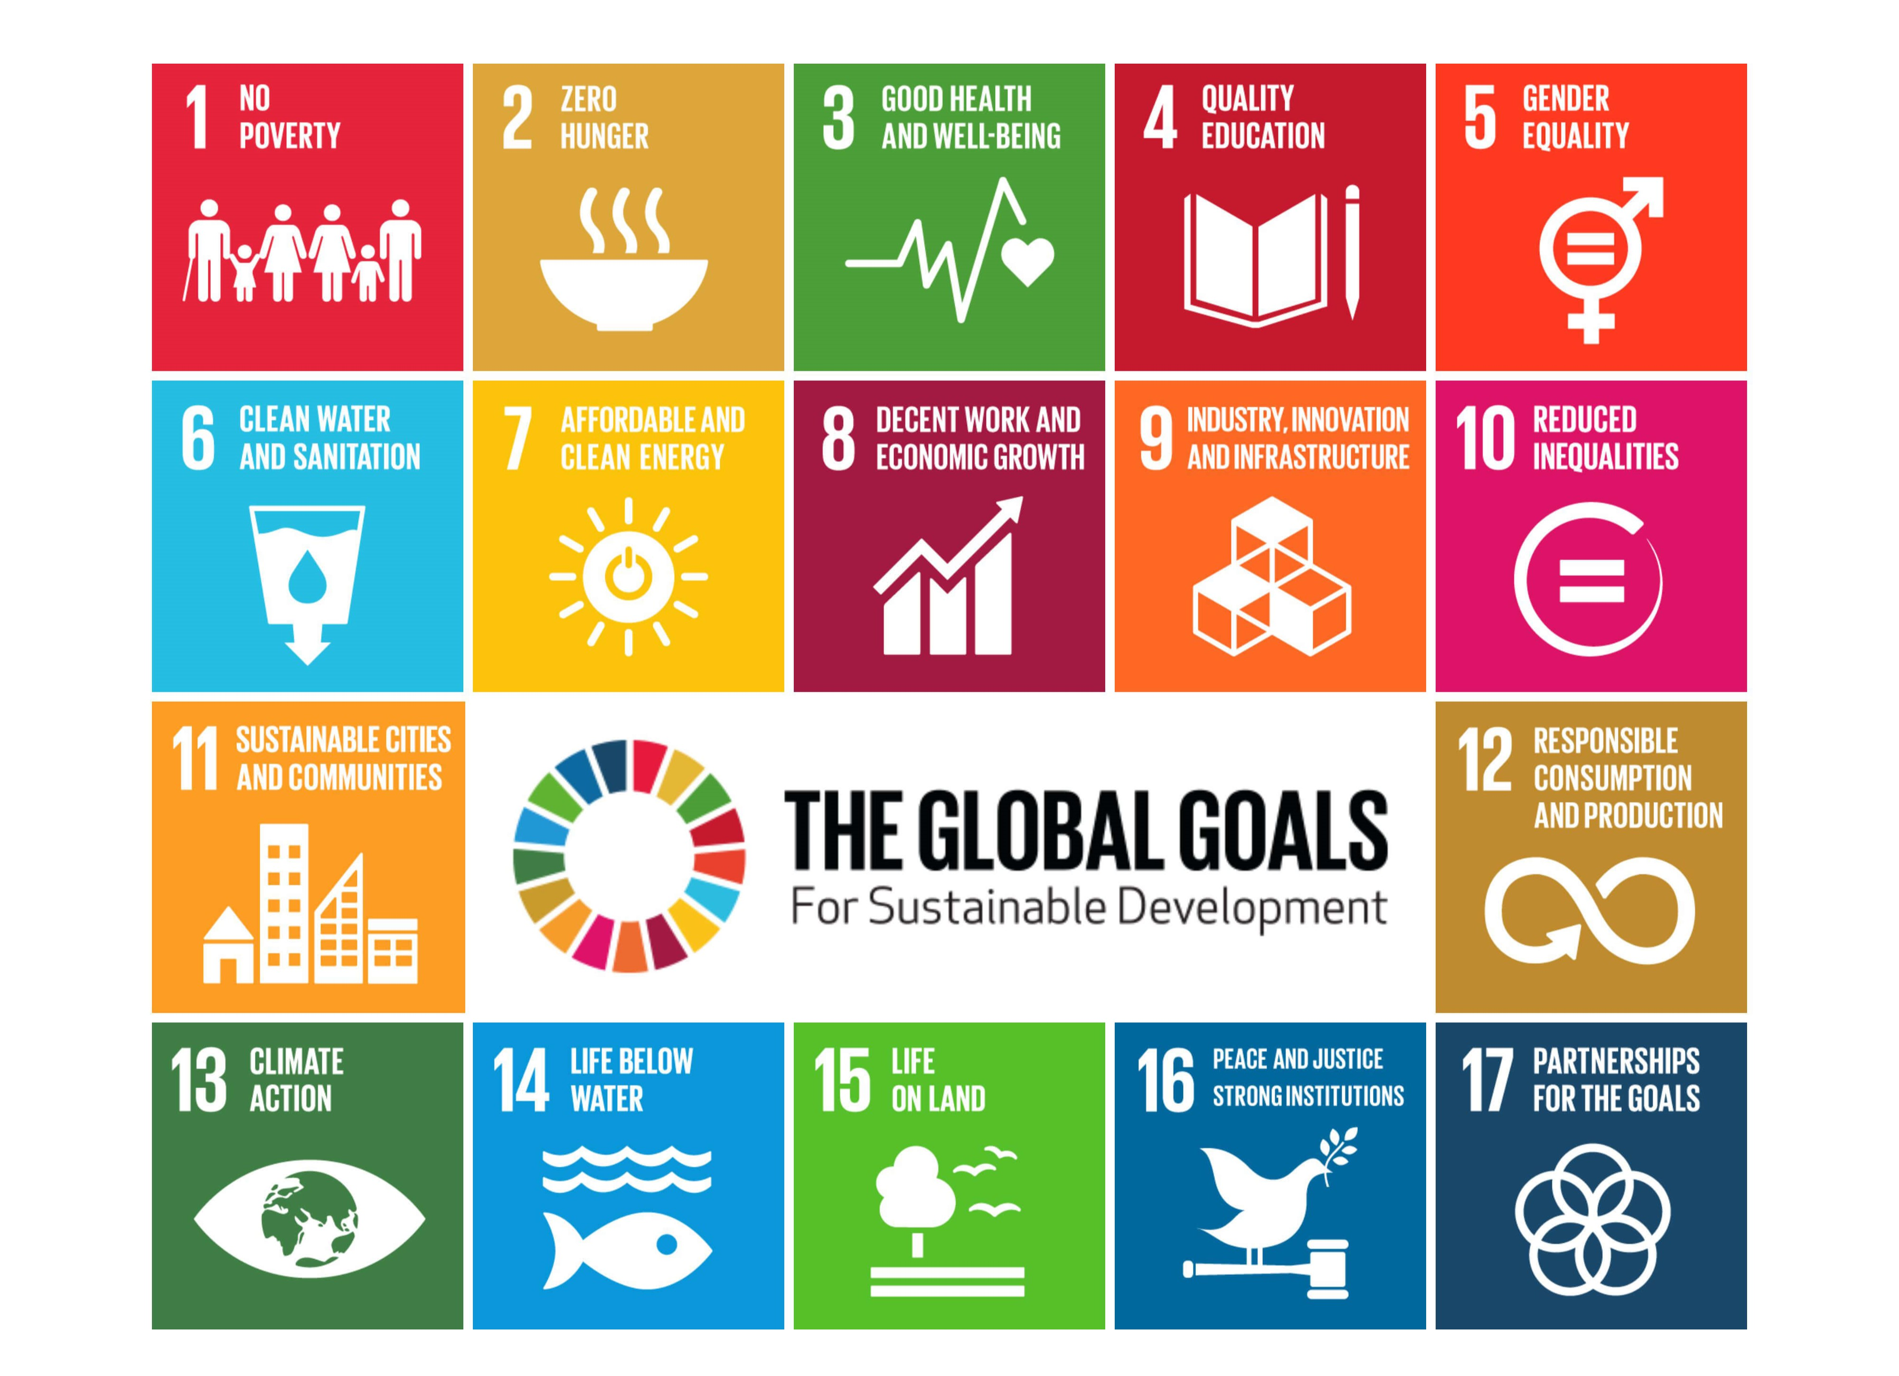
Contextualisation of current debate
Scholars in media and societal impact
Core ideas in the societal impact debate
University research should contribute (more explicitly) to societal challenges
Growing interest in societal impact of university research (SIUR) outside the pure academic (publication indexes) and economic fields (spin-offs)
  Moving beyond traditional modes of research evaluation (bibliometric & scientometric instruments)
  Growing requirements to demonstrate societal value of research (REF [UK], impact cases, SIAMPI-method)
Negative conceptualization of SIUR, need for research expansion

Slide 16

Contextualisation of current debate
Scholars in media and societal impact
Core ideas in the scholars in non-academic media debate
Growing emphasis on open science and science communication → importance of including non-scholarly communication practices scholars engage in
Importance of democratizing or popularizing science → scholars engaging in disseminate research findings → beneficial societal results
  Universities increasingly fund specialized departments to secure media coverage (institutional component)
  Altmetrics: track popular dissemination of published research (instrumental component)
  Growing number of scholars using different media to disseminate findings (network component)

Slide 17
Contextualisation of current debate
Arriving at the current problem
Qualitative assessments models (case studies, impact cases, REF, SIAMPI) value media attention and presence as (potentially and partial) SIUR
Transfer of knowledge → pathway by which university benefits society → advancing the public understanding of science (PUS)
However: no differentiation between public attention for researcher's vs their output → relies on self-reporting
Often social media diffusion is referred to (altmetrics), is however more complex (cf. academic spamming, homogenous bubble of social media followers)
Written press documents → less academic spamming, considered pertinent SIUR form

Slide 18
Contextualisation of current debate
Is written press media attention for scholars a valid proxy for SIUR?
Scientific research
Expert knowledge
Expert research
Written press media
Dissemination of research findings
Scholars explaining complex phenomena
SIUR
Democratization of science
Advancing PUS
→ Investigating this taken for granted assumption

Slide 19




Methods
Selecting social scientists
All active researcher personnel (using FRIS database), working at universities in Flemish Community → N = 1.704 social scientists
  Predoc, postdoc, professor, emeritus
  Not: ATP (administrative), volunteer personnel, library personnel, etc.
Working at a social sciences department or faculty
  Sociology, political sciences, communication sciences
  UHasselt → excluded, no social science department
Querying full name in Belgian media database GoPress
  Dutch speaking newspapers and magazines of 2019
Notes:
The focus on social scientists reflects the more pressing demand for alternative quality indicators in social sciences and humanities disciplines (Gijselinckx & Steenssens, 2011)

Slide 20
Disentangeling higher written press attention
Skewed distribution
Media attention for social scientists in Flanders was highly skewed
Scientific elite (Jensen, 2008) or public intellectuals (Bastow, 2014)
Excellent professors accredited for excellent “translating” of knowledge on virtually any issue?
A monopoly on (conventional) media attention?
7 male professors claimed 48,6% of all media attention of 2019
86,1% of social scientists did not appear in 2019 media
Notes:
“the scientific elite is able to transform its symbolic capital (Bourdieu, 1984), gained in the academic arena, into public arenas, thus popularizing not only on issues directly related to their own domain but on virtually any issue” Jensen, 2008.

Slide 21
Patterns in gender, career position and media attention
Prominence of Male professors
2019 media: career & gender | Gender
 | Men % | Women % | Total %
Predoc | 19 8,0% | 22 9,3% | 41 17,4%
Postdoc | 28 11,9% | 29 12,3% | 57 24,1%
Professor | 95 40,3% | 32 13,6% | 127 53,8%
Emeritus | 10 4,2% | 1 0,4% | 11 4,7%
Total N = 1.704 | 152 64,4% | 84 35,6% | 236 100%
Male social scientists appeared almost twice as many times (64,4% vs. 35,6%) in media than female –
47,8% of social scientists
(N = 1.7O4) was female → underrepresentation of female social scientists in 2019 media
Dominance of professorial staff (53,8%)
Often head of institute (higher authority than individual researcher)
Notes:
Media appearance therefore “remains largely institutionalized, bound to leadership roles, regulated by scientific and organizational norms” (Dunwoody et al., 2009, p. 306)

Slide 22
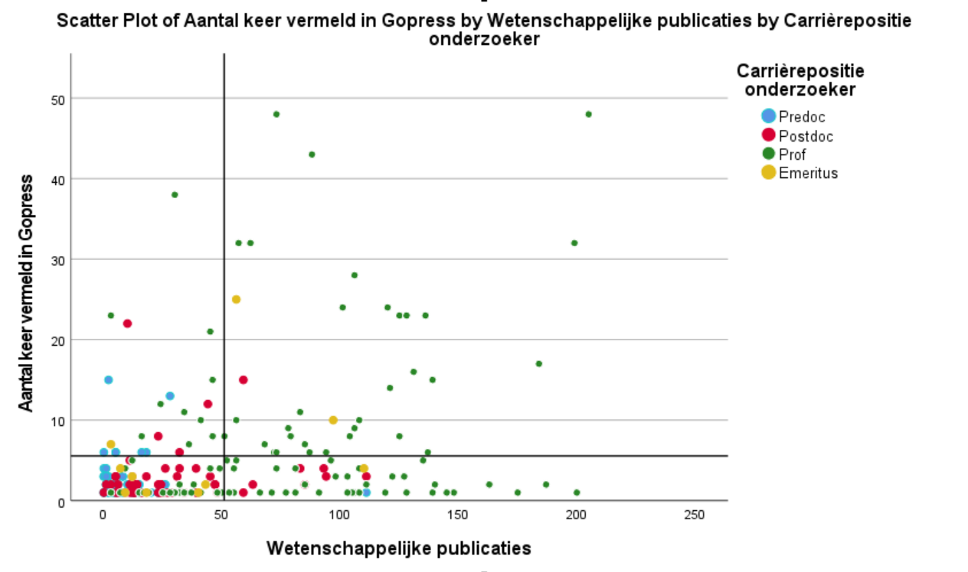
Quadrant analysis of productive researcher
career position
Scientific publications correlate with media attention
(β = .32, p < .001) → spurious relationship
After controlling for #years active correlations still stands
(β = .19 with p = .004)
→ Status remains important in media attention for scholars

Slide 23
Diving deeper into media attention
Distinguishing types in media attention
Types of media attention | Count | Percentage
Active
Column (weekly) | 121 | 5,1
Book review | 4 | 0,2
Opinion piece | 144 | 6,1
Total | 265 | 11,3
Passive
Discussion of research | 173 | 7,3
Interviewed | 114 | 4,8
Namedropping | 385 | 16,4
Opinion piece | 144 | 6,1
Personal portrait | 8 | 0,3
Public lecture announcement | 49 | 2,1
Quote | 11 | 0,5
Referencing another researcher | 30 | 1,3
Short explanation | 1.315 | 55,9
Total | 2.089 | 88,7
Most articles (88,7%) not written by researchers → called for expertise → passive
Explanatory statement is most occurring type (55,9%)
Link to research of expert is hardly demonstratable
Discussion of research → ideal type for SIUR, however: only 7,3% of media mentions
As researcher’s status goes up, so does proportion of media attention with no impact → namedropping, quote, public lecture announcement → 19% is not relevant to SIUR

Slide 24
Is written media presence a proxy of Siur?
Scientific research
Expert knowledge
Expert research
Written press media
Dissemination of research findings
Scholars explaining complex phenomena
SIUR
Democratization of science
Advancing PUS
Not quite
Presence in popular media outlets is often referred to by researchers and universities as a valid (yet partial) indication of SIUR
Accepting this taken for granted assumption simplifies how media covers scientific knowledge
Ignores persistent patterns in status and gender (beyond media logic)
  More of a privilege instead of accessible strategy → who has the privilege to advance PUS?
Potential to signal research uptake and scientific contributions to public debate, however a small number of instances had considerable potential for SIUR + higher proportion of no impact appearances in case of higher status researchers
  Important to differentiate weekly opinions of high-profile professor from research-based public interventions
  Beyond media attention as a quantifiable proxy for societal impact
Notes:
Another reason media appearance as a quantifiable variable is unfit for model-based funding allocation, is the fact that comparing departments, universities or researchers institutes by it is quite meaningless, since the existence of the scientific elite, current events in the media landscape

Slide 25
Thank you for your attention
Hans Jonker^{1,2}
Hans.Jonker@vub.be

Slide 26
Impact of Social Sciences, Humanities and Arts
13-15 October, 2021
Thank you!
#SSHA21

